Slide 1


VISVESVARAYA TECHNOLOGICAL UNIVERSITY, BELAGAVI-590018, KARNATAKA
Bapuji Institute of Engineering and Technology
Davanagere-577004
Department of Computer Science and Design
“PROJECT PHASE - I PRESENTATION”
on
Title: Deep Vision: AI – Based Intelligent Surveillance
Presented By:
Joycina Shiny M Achary 4BD23CG015
Lakshmi S Acharya 4BD23CG017
Arjun G R 4BD24CG401
Vaibhav S Wandkar 4BD24CG409
Project Guide: Project Coordinator: Program Coordinator:
Prof. Kaveri.C B.E, M.Tech. Dr. Sreenivasa B R B.E, Ph.D. Dr. Chetana Prakash M.S., Ph.D
dept. CS&D professor of dept. CS&D professor & head of dept. CS&D

Slide 2
CONTENTS :
Introduction
Literature Survey
Problem Statement
Objectives
System Requirements
Methodology

Slide 3
INTRODUCTION :
Deep Vision Surveillance is an AI-based system that monitors video live events and detects suspicious activities in real time. Unlike traditional CCTV systems that depend on constant human observation, it uses Artificial Intelligence and Computer Vision to automatically analyze footage and generate instant alerts. This improves security, reduces human effort, and ensures faster response to possible dangers.

Slide 4
LITERATURE SURVEY :
Sl.No | Title | Publication | Authors & Year | Methodology (Tools, Technologies, Framework) | Gaps Identified
1. | Suspicious Activity Recognition Using YOLO Algorithm | JETIR | Gurramkonda Kavya et al., 2023 | YOLO-based object detection with real-time video analysis and SMS alert system | Limited accuracy in complex environments and lacks advanced temporal modeling
2. | Human Anomaly Detection System Using YOLOv8 and LSTM | IJRASET | Jash Tandel et al., 2024 | Uses YOLOv8 for object detection and LSTM for temporal behavior analysis with attention mechanisms | Difficulty in combining spatial and temporal features; limited scalability and dataset diversity

Slide 5
Sl.No | Title | Publication | Authors & Year | Methodology (Tools, Technologies, Framework) | Gaps Identified
3. | Security and Surveillance: Human and Suspicious Object Detection Using YOLOv8 | IJCRT | Abhishek S. Munavalli et al., 2025 | YOLOv8 + object tracking + Owner Association algorithm + Flask-based monitoring system | Lacks deep behavioral understanding and limited contextual reasoning in complex scenarios
4 | Enhanced Framework for Real-Time Dense Crowd Abnormal Behavior Detection Using YOLOv8 | Artificial Intelligence Review | Rabia Nasir et al., 2025 | YOLOv8 with Soft-NMS, evaluated on Hajjv2 dataset for crowd anomaly detection | Challenges like occlusion, illumination variation, and high false positives in dense crowds
5 | Smart Surveillance Systems Using YOLOv8: A Scalable Approach | IJRAET | P. Siva et al., 2025 | YOLOv8 + CNN + LSTM for real-time crowd monitoring and anomaly detection | High computational cost and dependency on large datasets; edge deployment challenges
6 | AI-Driven Cognitive Surveillance Framework for Suspicious Activity Detection | Advances in Science and Technology Research Journal | Asad Hameed Soomro et al., 2025 | HYDPL algorithm (YOLO + DenseNet + pseudo-labeling) with multi-stage processing | Limited dataset scope (academic environment only); lacks generalization

Slide 6
Sl.No | Title | Publication | Authors & Year | Methodology (Tools, Technologies, Framework) | Gaps Identified
7. | Real-Time Intelligent Surveillance System Using YOLOv8 and DeepFace | MDPI Eng. Proc. | Uswa Ihsan et al., 2025 | YOLOv8 + DeepFace for object detection and emotion recognition | Issues with misclassification, dataset bias, and limited explainability
8. | Improving Public Safety Through AI-Driven CCTV Surveillance Systems | IJPREMS | Aileni Eenaja et al., 2025 | YOLOv8 + ML-based anomaly detection + real-time alert system | High false positives and limited adaptability in dynamic environments
9. | Smart AI Surveilance for Crowd and Threat Detection | IJRAET | Multiple Authors,2025 | YOLOv8 + deep learning + behavioral analysis + real-time monitoring dashboards | Requires high computational resources and lacks robustness in real-world noisy data
10. | AI-Based Military Intrusion Detection System Using YOLOv8 | IJSCI | V. Monica et al., 2026 | YOLOv8 with polygon-based boundary detection + alert system (alarm, logs, video capture) | Focused only on intrusion detection; lacks behavior classification and anomaly diversity

Slide 7
PROBLEM STATEMENT :
Modern surveillance systems generate large volumes of video data that are difficult to monitor continuously across multiple locations. Traditional CCTV relies on human observation, which is time-consuming and likely to make errors due to tiredness and lack of focus. This can lead to missed or delayed detection of suspicious activities, unauthorized access, and other security threats, reducing overall safety and efficiency.

Slide 8
OBJECTIVES :
Develop an AI-Based Surveillance System
To create an intelligent system that can automatically monitor live events in real time using AI. This reduces manual effort and enables continuous real-time surveillance.
2. Implement Object Detection and Tracking
To detect and track people, vehicles, and objects across video frames.This ensures accurate monitoring of movements and activities.

Slide 9
OBJECTIVES :
3. Detect Suspicious Activities and Behavior
To analyze patterns and identify unusual or harmful activities like theft or wandering, trespassing, etc.This helps in early detection of potential security threats.
4. Generate Real-Time Alerts for Quick Response
To send instant alerts with useful information when suspicious activity is detected.This allows security personnel to respond quickly and effectively.

Slide 10
SYSTEM REQUIREMENTS :
Software Requirements:
Programming Language
Python
Computer Vision Library
OpenCV
Operating System
Windows
Development Environment
Visual Studio Code
Alert & Notification System
SMTP (Email Alerts)
Twilio – Used for sending SMS notifications
Machine Learning Frameworks
TensorFlow

Slide 11
Algorithms Used:
YOLO (You only Look Once)
CNN (Convolutional Neural Network)
Optical Flow (motion-estimation algorithm)
Pose Estimator
Autoencoder (Anomaly Detection)
Isolation Forest
Event-driven Algorithm
Hardware Requirements:
Webcam or CCTV Camera
Computer System (CPU/GPU)

Slide 12
METHODOLOGY :
Video Input Acquisition
The system collects video data from CCTV cameras, webcams, or stored datasets. This video acts as the main source for further analysis.
Frame Extraction and Preprocessing
The video is split into individual frames for detailed processing .Techniques like resizing and noise reduction improve image quality and consistency.

Slide 13
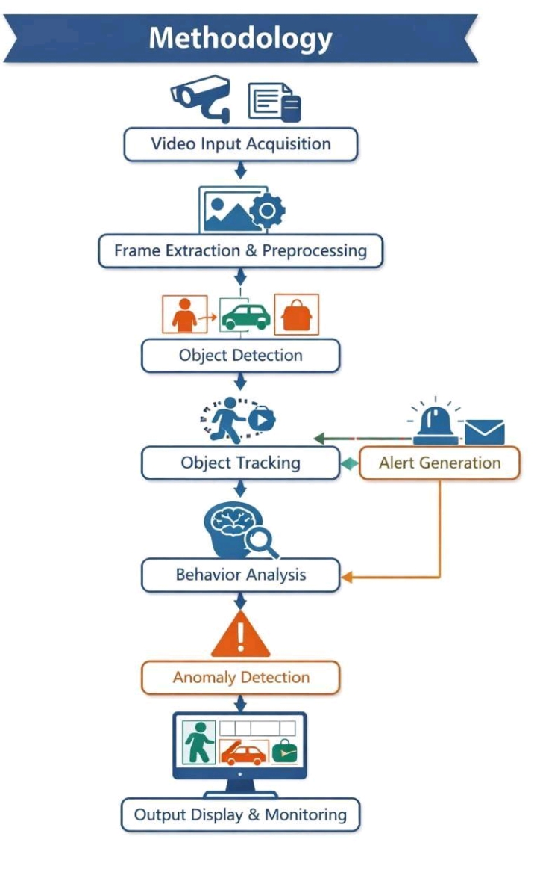
Object Detection
Each frame is analyzed to detect objects such as people, vehicles, and bags.This helps the system focus only on important elements in the scene.
Feature Extraction and Behavior Analysis
Key features like movement, speed, and direction are extracted from objects.These features help in understanding normal activity patterns.

Slide 14
Anomaly Detection
The system identifies unusual activities by comparing with learned normal behavior.
Any abnormal pattern is marked as suspicious.
Alert Generation System
When suspicious activity is detected, alerts are generated instantly.Notifications or alarms are sent to security personnel for quick action.

Slide 15
REFRENCES :
Gurramkonda Kavya and G. Umamaheswar Reddy, “Suspicious Activity Recognition Using YOLO Algorithm,” Journal of Emerging Technologies and Innovative Research (JETIR), 2023.
J. Tandel, S. Darak, K. Desai, M. Desai, and M. Kothari, “Human Anomaly Detection System Using YOLOv8 and LSTM,” International Journal for Research in Applied Science & Engineering Technology (IJRASET), 2024.
Jash Tandel, Siddhesh Darak, Khagesh Desai, Meet Desai, and Mayank Kothari, “Human Anomaly Detection System Using YOLOv8 and LSTM,” IJRASET, 2024.

Slide 16
R. Nasir, Z. Jalil, M. Nasir, T. Alsubait, M. Ashraf, and S. Saleem, “An Enhanced Framework for Real-Time Dense Crowd Abnormal Behavior Detection Using YOLOv8,” Artificial Intelligence Review, 2025.
P. Siva, G. B. Pujitha, G. Siva Krishna, G. Hemanth, and B. M. S. Teja, “Smart Surveillance Systems Using YOLOv8: A Scalable Approach for Crowd and Threat Detection,” International Journal of Recent Advances in Engineering and Technology, 2025.
A. H. Soomro, R. H. Arain, and R. A. Shaikh, “AI-Driven Cognitive Surveillance Framework for Suspicious Activity Detection in Academia,” Advances in Science and Technology Research Journal, 2025.

Slide 17
U. Ihsan, N. Z. Jhanjhi, H. Ashraf, F. Ashfaq, and F. A. Wicaksana, “A Real-Time Intelligent Surveillance System for Suspicious Behavior and Facial Emotion Analysis Using YOLOv8 and DeepFace,” Engineering Proceedings, 2025.
A. Eenaja, R. Gunda, K. Ashwini, P. Keerthi, and N. Sravani, “Improving Public Safety Through AI and Machine Learning-Driven CCTV Surveillance Systems,” International Journal of Progressive Research in Engineering Management and Science (IJPREMS), 2025.
A. S. Munavalli, A. S. Sheelimath, H. M. Kalkumkar, K. S. Ashtekar, and A. M. Hanchinal, “Security and Surveillance: Human and Suspicious Object Detection Using YOLOv8,” International Journal of Creative Research Thoughts (IJCRT), 2025.
V. Monica and N. Saranya, “AI-Based Military Intrusion Detection System Using YOLOv8,” International Journal of Sciences and Innovation Engineering (IJSCI), 2026.

Slide 18
THANK YOU…

